Slide 1
EURAXESS Online Tools To Support Researcher Career Development
Dean Hogan
Career Coach & Trainer
This project has received funding from the European Union’s Seventh Framework Programme for research, technological development and demonstration under grant agreement No 643330

Slide 2
This project has received funding from the European Union’s Seventh Framework Programme for research, technological development and demonstration under grant agreement No 643330

Slide 3
Expectations & Desired Outcomes
Familiarity with the online tools and the principles behind them.
The sequential steps to using the tools to maximum effect.
The primary importance of skills and the skills audit.
The self-assessment, values, interests & personality.
Transferrable skills.
Communication skills.
D.O’s.> Develop an appreciation for the benefits of
Researcher Career Development, understand how to use
these tools and take up their use for your own benefit or
for the benefit of your researchers & post grads.
This project has received funding from the European Union’s Seventh Framework Programme for research, technological development and demonstration under grant agreement No 643330

Slide 4
Self-directed career planning & development
Online Tools
Researcher Pipeline
Awareness – Engagement – CD Activities – CD Plan – Self-directed researchers
This project has received funding from the European Union’s Seventh Framework Programme for research, technological development and demonstration under grant agreement No 643330

Slide 5
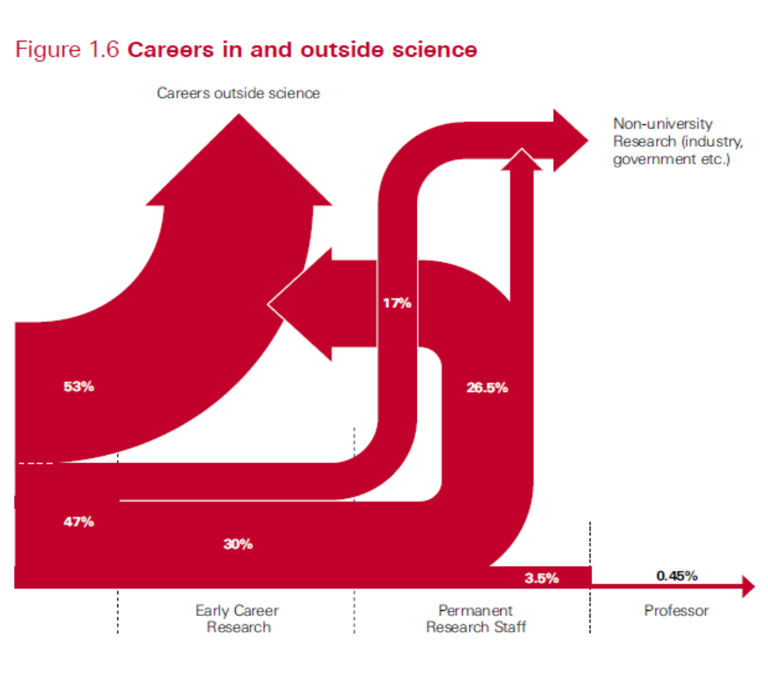
This project has received funding from the European Union’s Seventh Framework Programme for research, technological development and demonstration under grant agreement No 643330

Slide 6
Focus on Practicalities
We have a problem with engagement.
Deliver on a promise.
Tool must provide a usable output/results.
Increase buy-in.
Keep it simple.
Recognise the realities of the researcher’s working life.
Confidence & motivation.
Possible workshop & solutions to fill the gaps.
Could also be used at PhD level.
This project has received funding from the European Union’s Seventh Framework Programme for research, technological development and demonstration under grant agreement No 643330

Slide 7
How Many Tools?
1. My IDP – Science Careers (website).
2. PsychCentral (website).
3. National Postdoctoral Association (website).
4. DISCOVER – Careers Beyond Academia (website).
5. INTERACT- Academia Reaching Out To Business (website).
6. Career Development Toolkit for researchers (ebooklet).
7. 10 Career Paths for PhDs (ebooklet).
8. The 5-Minute Career Action Plan (ebooklet).
This project has received funding from the European Union’s Seventh Framework Programme for research, technological development and demonstration under grant agreement No 643330

Slide 8
Where Are They?
This project has received funding from the European Union’s Seventh Framework Programme for research, technological development and demonstration under grant agreement No 643330

Slide 9
Where Are They?
This project has received funding from the European Union’s Seventh Framework Programme for research, technological development and demonstration under grant agreement No 643330

Slide 10
Sequential Steps
1. Where am I now?
2. Self-assessment (VIPS)
Interests
Values
Skills Audit
Personality
3. Self-assessment interpretations
This project has received funding from the European Union’s Seventh Framework Programme for research, technological development and demonstration under grant agreement No 643330

Slide 11
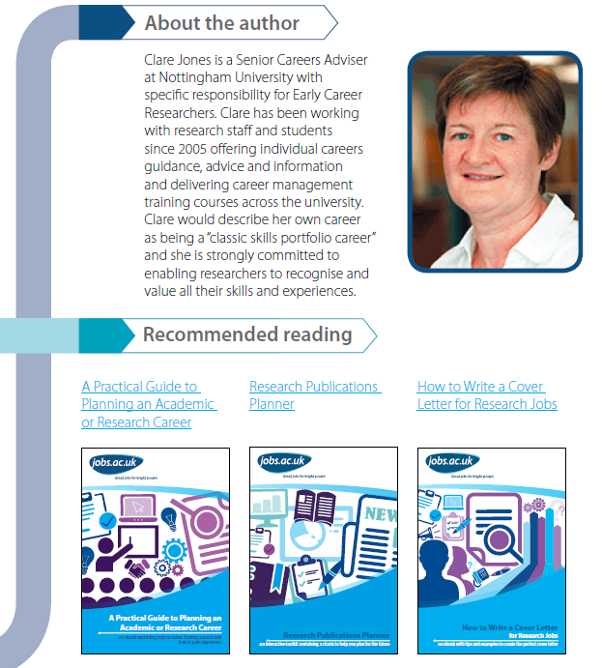
Notes:
Like all of the other tools, this one is excellent in its simplicity. The people who have developed these tools are credited on the website. If you have any doubts or hesitancy regarding career development and planning this is an excellent introduction.

Slide 12
Where am I now?

Slide 13
Career Development Toolkit for Researchers

Slide 14
This project has received funding from the European Union’s Seventh Framework Programme for research, technological development and demonstration under grant agreement No 643330

Slide 15
Self-assessment
VIPS
Values
Interests
Personality
Skills
The first three will point the researcher in the right
direction but skills will determine how they proceed
from there.

Slide 16
Why researcher career development is important.
This project has received funding from the European Union’s Seventh Framework Programme for research, technological development and demonstration under grant agreement No 643330

Slide 17
Skills
The primary importance of skills.
For a working researcher, your skills are your passport to wherever you wish to go to.
CV and job interviews.
Notes:
As a researcher it is important that you understand your skills and the number of ways that your skills can be applied.

Slide 18
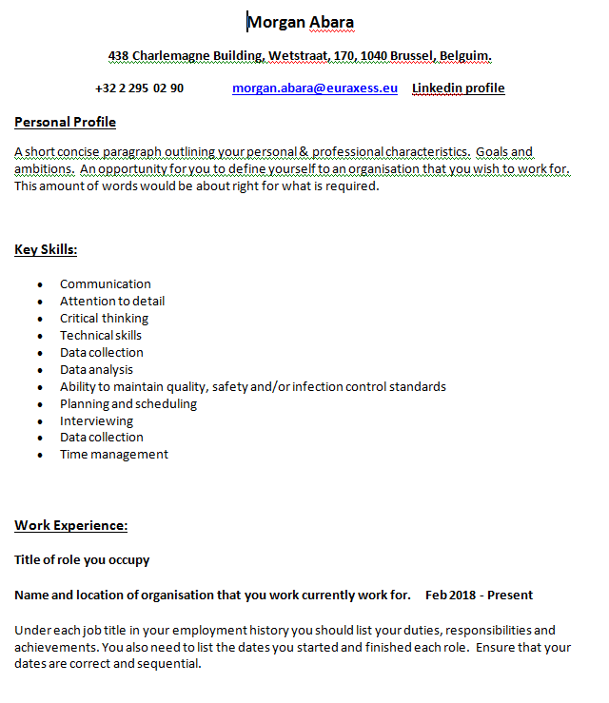
This project has received funding from the European Union’s Seventh Framework Programme for research, technological development and demonstration under grant agreement No 643330
Notes:
Please take a look at this generic CV. Now because it is a generic CV the content is also generic. But I want look at the layout which is the recommended, standard layout. First is Personal profile, a variation on your “elevator pitch”. Next comes your Key Skills. Now the first skills that you list would be those that correspond to the job advertisement that you are replying to. The advertisement would have listed the required skills for the role and your CV must match that. A real CV would have specific research skills near the top, these are skills that could apply to most researchers.

Slide 19
Self-assessment
Skills Audit
Pre-workshop activities
Each participant make a full list of all their skills
Bring a copy of their most recent CV
Workshop activities
Add to list all skills from all previous employment
Use online supports to prompt additions to the list (Google)
This project has received funding from the European Union’s Seventh Framework Programme for research, technological development and demonstration under grant agreement No 643330

Slide 20
Skills Audit

Slide 21
Skills Audit
This project has received funding from the European Union’s Seventh Framework Programme for research, technological development and demonstration under grant agreement No 643330

Slide 22
Skills Audit
This project has received funding from the European Union’s Seventh Framework Programme for research, technological development and demonstration under grant agreement No 643330

Slide 23
Skills Audit

Slide 24
Skills Audit

Slide 25
Skills Audit
Final skills exercise
The much larger skills list should be categorised.
Motivated skills (skills I enjoy using)
Development skills (skills I would like to develop and use more)
Burnout skills (skills I would prefer not to use)
Skills not important at this time
This project has received funding from the European Union’s Seventh Framework Programme for research, technological development and demonstration under grant agreement No 643330

Slide 26
Motivated Skills
(Skills I enjoy using and would like to use more)
Development Skills (Skills I believe that I enjoy using but need to develop further)
Burnout Skills (Skills I would prefer not to use)
Skills Not Important at this time
This project has received funding from the European Union’s Seventh Framework Programme for research, technological development and demonstration under grant agreement No 643330
Notes:
This is what it would look like and it should help clarify your thinking..

Slide 27
Motivated Skills
(Skills I enjoy using and would like to use more)
These are the skills you should look to use as frequently as possible.
Development Skills (Skills I believe that I enjoy using but need to develop further)
These are skills that are not yet fully developed but you would like to use them more.
Burnout Skills (Skills I would prefer not to use)
Skills that you may have a high proficiency in but do not wish to use them for the moment.
Skills Not Important at this time
This project has received funding from the European Union’s Seventh Framework Programme for research, technological development and demonstration under grant agreement No 643330

Slide 28
Transferrable Skills
Communication Skills
This project has received funding from the European Union’s Seventh Framework Programme for research, technological development and demonstration under grant agreement No 643330
Notes:
The skills lists should be added every time you complete new training

Slide 29
This project has received funding from the European Union’s Seventh Framework Programme for research, technological development and demonstration under grant agreement No 643330

Slide 30
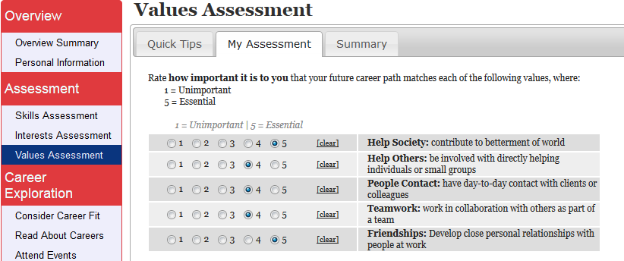
Self-assessment
Notes:
Your interests are your passions. The things that get you out of bed in the morning. These are the areas that fascinate and intrigue you. Ideally you want your career to reflect your passions. It logically follows that if you work at something you enjoy, you are educated and trained to do it, you should be very good at it and will be financially compensated accordingly.
Your values are your anchors and your core beliefs. If possible you do not want to be in a professional environment that is in conflict with your values as it has proven to be stressful, unhealthy and demotivating. Apart from working in direct conflict with your values sometimes a more common situation is to have conflicting values. For example, you might consider yourself environmentally conscious and responsible to the point of it being an important value to you. However, you might also place a high personal value on having a good standard of living and getting a salary that will ensure that standard of living. Then you might find yourself with a well-paid job working for a company with a terrible environmental record. The golden handcuffs. So instead of just doing your work like every day you end up having a lot of internal dialogues.

Slide 31
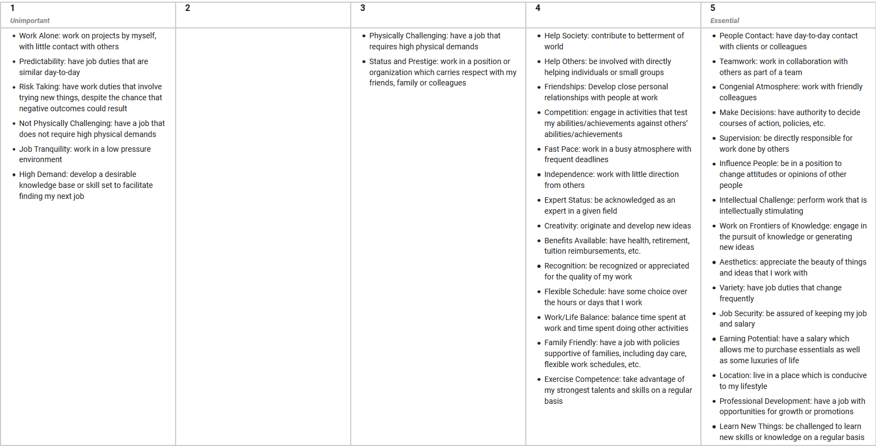
This project has received funding from the European Union’s Seventh Framework Programme for research, technological development and demonstration under grant agreement No 643330

Slide 32
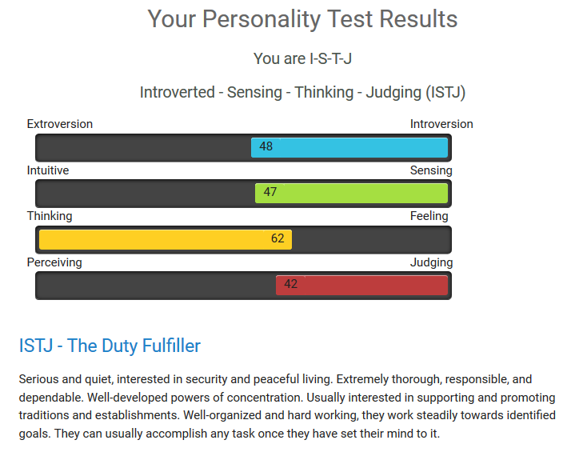
Self-assessment
Personality
Notes:
You can say similar things about personality. Again if your are an introverted person and your job requires you to be an extrovert, or vice-versa, that can be a big problem. When you speak to people who are really unhappy in their job and feel trapped, they usually speak about having few choices or options, for various circumstances or reasons. And it does not matter if they are at the top of the pay scale or the bottom, it’s the same experience. Like I said earlier, this is all about enabling researchers to provide themselves with choices, opportunities and options. There are many similar free personality tests available online. This is not a diagnostic personality instrument but merely another indicator to be used for possible career choices. These online tools save time for everybody, especially the researcher.

Slide 33
Self-assessment results
So what to we have at the end of the self-assessment?
Skills Audit (categorised skills list)
Values, Interests & Personality results
Career Development Toolkit
E-Booklets
This project has received funding from the European Union’s Seventh Framework Programme for research, technological development and demonstration under grant agreement No 643330

Slide 34
Self-assessment results
List all of the indicators:
Where Am I Now? Motivated Skills
Development Skills Burnout Skills
Skills Not Important Transferrable Skills
Communications Skills Values
Interests Personality
This project has received funding from the European Union’s Seventh Framework Programme for research, technological development and demonstration under grant agreement No 643330

Slide 35
Self-assessment interpretations
All of the indicators from the skills audit, the interests, values and personality tests should be reviewed.
What are the strongest indicators?
What directions do they point the researcher in?
Try to develop a “targeted list” of indicators, what themes/topics are repeated?
This project has received funding from the European Union’s Seventh Framework Programme for research, technological development and demonstration under grant agreement No 643330
Notes:
Usually there is a lot of consistency in the indicators. This is a tremendous amount of information that should be of huge benefit to informing the researcher’s decision making. There is usually a consistency in these numerous indicators that point the researcher in a general, if not more specific, direction.

Slide 36
Careers Exploration

Slide 37
Job searching
https://euraxess.ec.europa.eu/jobs/search
Excellent EURAXESS employment site.
https://www.researchgate.net/jobs?regions=&page=1
Networking tool for researchers.
https://www.linkedin.com/jobs/
Professional networking and employment tool.
https://www.jobs.ac.uk/media/pdf/careers/resources/building-academic-job-applications-a-quick-practical-guide-for-early-career-researchers.pdf
Practical advice of job searching and CV building.
https://euraxess.ec.europa.eu/content/lists-platforms
EURAXESS job platform.

Slide 38
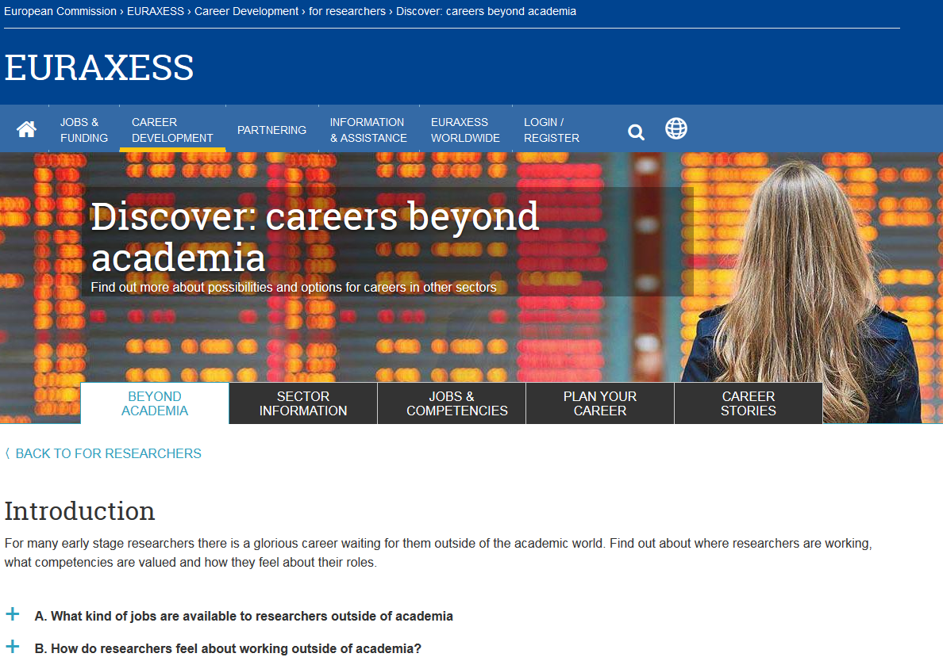
Careers Exploration
Notes:
E Booklet Review

Slide 39
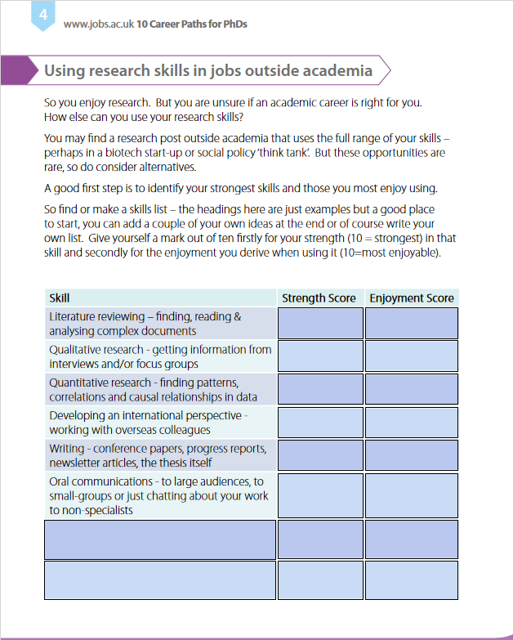
This project has received funding from the European Union’s Seventh Framework Programme for research, technological development and demonstration under grant agreement No 643330
Notes:
10 Career Paths for PhDs. Using your research skills outside of academia, developing an international perspective, the important communications skills and how to prepare to move your employment into another sector. Helps you to do a quick skills audit so that you can surprise yourself by how many transferrable skills that you have. As you can see, this tool was developed in the UK and some of the wording and content is UK-centric but it is still a very helpful tool.

Slide 40
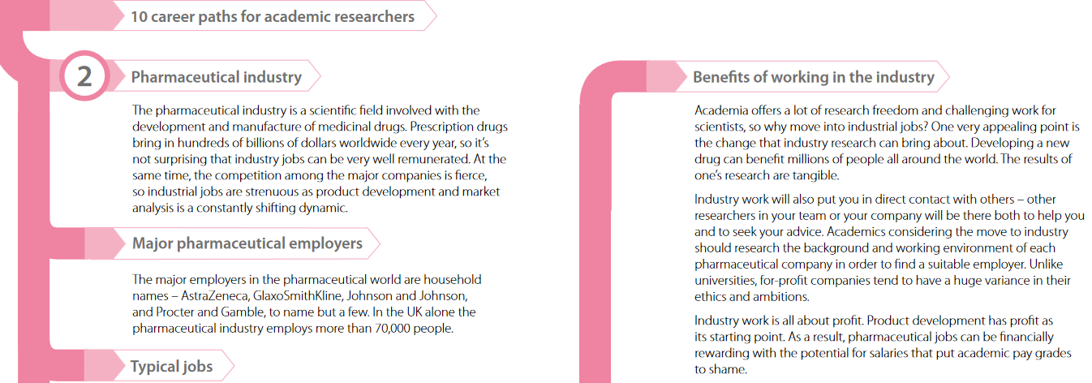
This project has received funding from the European Union’s Seventh Framework Programme for research, technological development and demonstration under grant agreement No 643330
Notes:
Designed for PhD’s or early career researchers thinking of a career outside of academia and want to know the types of job opportunities open to researchers. Contains information on using researcher skills outside of academia, transferring your skills outside of academia, relevant case studies, 10 alternative career paths, working in other sectors.

Slide 41
This project has received funding from the European Union’s Seventh Framework Programme for research, technological development and demonstration under grant agreement No 643330

Slide 42
This project has received funding from the European Union’s Seventh Framework Programme for research, technological development and demonstration under grant agreement No 643330

Slide 43
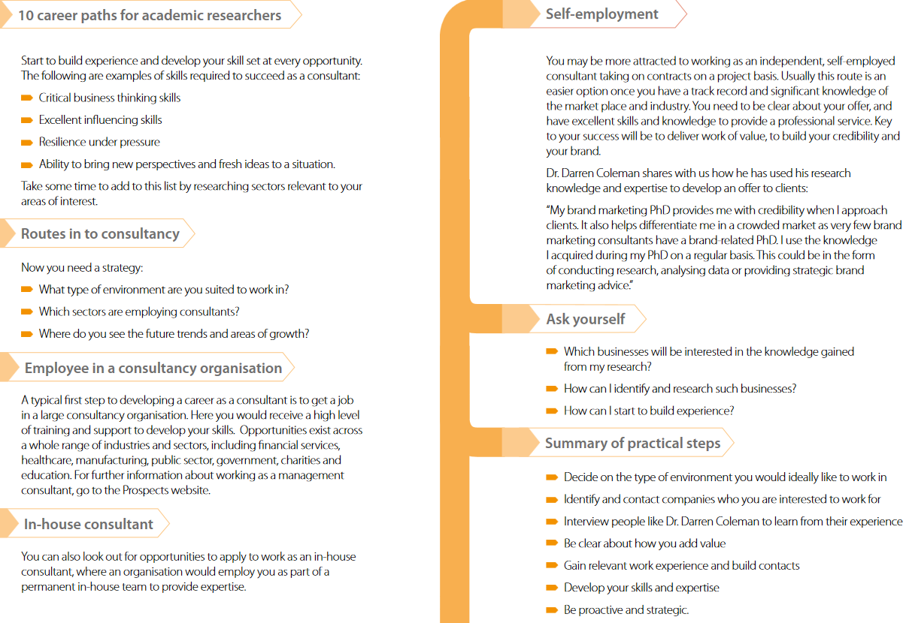
This project has received funding from the European Union’s Seventh Framework Programme for research, technological development and demonstration under grant agreement No 643330

Slide 44
End Goal:
Specific Job or Role & Location
Interim Roles & Experiences
Training & Qualifications
Short term goals
Where Am I Now?
This project has received funding from the European Union’s Seventh Framework Programme for research, technological development and demonstration under grant agreement No 643330

Slide 45
Goal setting & planning
Notes:
Once the researcher decides upon a general career path they will need to draw up an action plan, itemising short and long term goals. The goals will detail (as much as possible) all identified/required training and the desired sequential career steps.
The 5-Minute Career Action Plan is an excellent resource that focuses the mind of the researcher on the important questions that inform an action plan.
My IDP-Science Careers provides practical advice and templates for goal setting and planning.

Slide 46
This project has received funding from the European Union’s Seventh Framework Programme for research, technological development and demonstration under grant agreement No 643330
Notes:
Here we have an example of a Career Action Plan. There are many different designs available online and I have not found one that would apply to all researchers. If you are looking for a template just search online in google images and you will see many different templates. You can choose one that you like or adapt one of them to suit your individual circumstances.

Slide 47
Self-assessment interpretations
1-on-1’s are currently our single biggest choke point
So how do we address it?
Possible sharing of resources
This project has received funding from the European Union’s Seventh Framework Programme for research, technological development and demonstration under grant agreement No 643330

Slide 48
Self-assessment interpretations
Coaching: Term comes from sport.
Open-ended questions:
What are the main reasons for you to think....?
How do you feel in that type of situation?
What are the most important aspects of....?
Why is this the most important value to you?
Reality Testing
Challenge
Body language
This project has received funding from the European Union’s Seventh Framework Programme for research, technological development and demonstration under grant agreement No 643330
Notes:
The aim is for the researcher take ownership of their values, interest, personality and skills results. Use their own words and priorities.
Tomorrow we will cover drawing up the development plan, goal-setting and reality testing. We’ll also take a look at careers exploration, networking and leadership in a career development context.

Slide 49
Reality testing

Slide 50
Reality Testing

Slide 51
Self-assessment interpretations
Identify barriers and plan to overcome them
Experience & qualification barriers
Internal barriers (low confidence, fear etc.)
Other barriers (health, physical, poor communication skills, finance, childcare, transport etc.)
Differentiate between real and perceived barriers.
This project has received funding from the European Union’s Seventh Framework Programme for research, technological development and demonstration under grant agreement No 643330

Slide 52
Thank you for your time and attention.
Any questions?
This project has received funding from the European Union’s Seventh Framework Programme for research, technological development and demonstration under grant agreement No 643330

